Slide 1
Week at A Glance for Science
January
9-13
Weather and
Climate

Slide 2
Teacher: | R. Johnson/ Mr. Smith | Grade Level: | 6th | Subject: | Earth Science
 | Monday | Tuesday | Wednesday | Thursday | Friday
Focus Standard(s) | S6E4.b | S6E4.b | S6E4.b,c | S6E4.c | S6E4.b,c
Learning Target(s) | How energy from sun transfers heat to air, land, and water. Heat transfer (conduction, convection, radiation). | How energy from sun transfers heat to air, land, and water. Heat transfer (conduction, convection, radiation). | Heat transfer (conduction, convection, radiation). Unequal heating and rotation of the Earth that cause wind systems. | Unequal heating and rotation of the Earth that cause wind systems. | Heat transfer (conduction, convection, radiation). Unequal heating and rotation of the Earth that cause wind systems.
Opening | Warm-up: Ch.13 WB | Warm-up: Ch.11 WB | Warm-up: Ch.11 | Warm-up: Ch.13 | Warm-up: Ch.13
Work Session | Video: Heat Transfer; TB p.389; Study Guide | Study Guide; Heat transfer worksheet; TB p.389 | Study Guide; Wind systems TB p.396 | Study Guide; Wind systems TB p.396 | Stations (Heat Transfer, Air, Land, Water, Wind Systems)
Closing | TOD | Think-Pair-Share | Three Learned Three Questions | Student Summarize | Think-Pair-Share
Minor Assignments Due |  |  | Quiz #1 (S6E4.b) |  | Heat Transfer Assignment (S6E4.b,c)
Major Assignments Due
Current Relearning & Reassessment Assignments (with due dates) |  | Quiz#1 S6E4.b on 1/1; R&R will be due by 1/18.
Vocabulary |  | Conduction, Convection, Radiation, Green House Effect, Wind, Local Winds
Upcoming Major Assignments |  | Science Fair Projects; Test #1 Jan.20

Slide 3
S6E4. Obtain, evaluate, and communicate information about how the sun, land, and water affect climate and weather.
Analyze and interpret data to compare and contrast the composition of Earth’s atmospheric layers (including the ozone layer) and greenhouse gases. (Clarification statement: Earth’s atmospheric layers include the troposphere, stratosphere, mesosphere, and thermosphere.)
Plan and carry out an investigation to demonstrate how energy from the sun transfers heat to air, land and water at different rates. (Clarification statement: Heat transfer should include the processes of conduction, convection, and radiation.)
Develop a model demonstrating the interaction between unequal heating and the rotation of the Earth that causes local and global wind systems.
Construct an explanation of the relationship between air pressure, weather fronts, and air masses and meteorological events such as tornados and thunderstorms.
Analyze and interpret weather data to explain the effects of moisture evaporating from the ocean on weather patterns and weather events such as hurricanes.

Slide 4
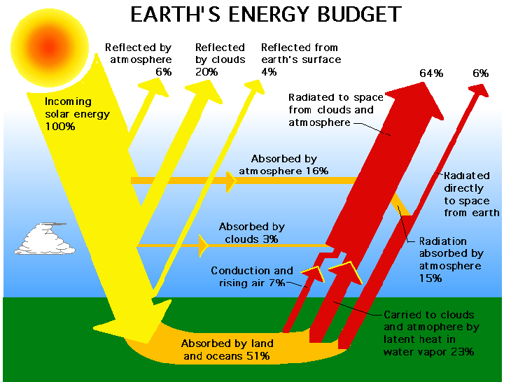
Plan and carry out an investigation to demonstrate how energy from the sun transfers heat to air, land and water at different rates.
(Clarification statement: Heat transfer should include the processes of conduction, convection, and radiation.)

Slide 5
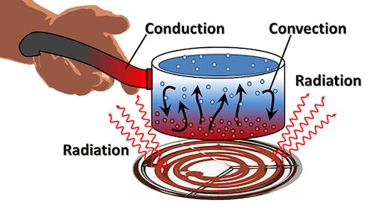

Slide 6
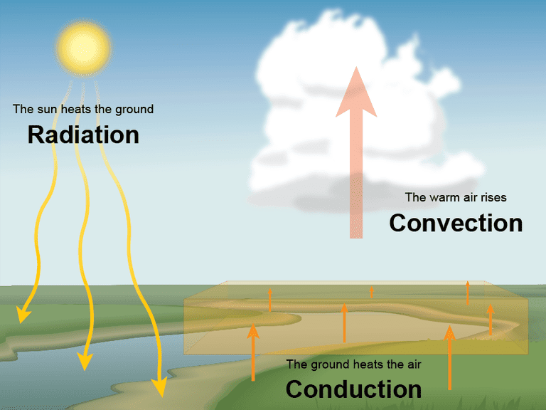
S6E4. Obtain, evaluate, and communicate information about how the sun, land, and water affect climate and weather.
B Plan and carry out an investigation to demonstrate how energy from the sun transfers heat to air, land and water at different rates. (Clarification statement: Heat transfer should include the processes of conduction, convection, and radiation.)
C Develop a model demonstrating the interaction between unequal heating and the rotation of the Earth that causes local and global wind systems.

Slide 8
radiation is the emission or transmission of energy in the form of waves or particles through space or through a material medium.
Conduction is the process by which heat is transferred from the hotter end to the colder end of an object. The ability of the object to conduct heat is known as its thermal conductivity, and is denoted k.
Convection the movement caused within a fluid by the tendency of hotter and therefore less dense material to rise, and colder, denser material to sink under the influence of gravity, which consequently results in transfer of heat.

Slide 9
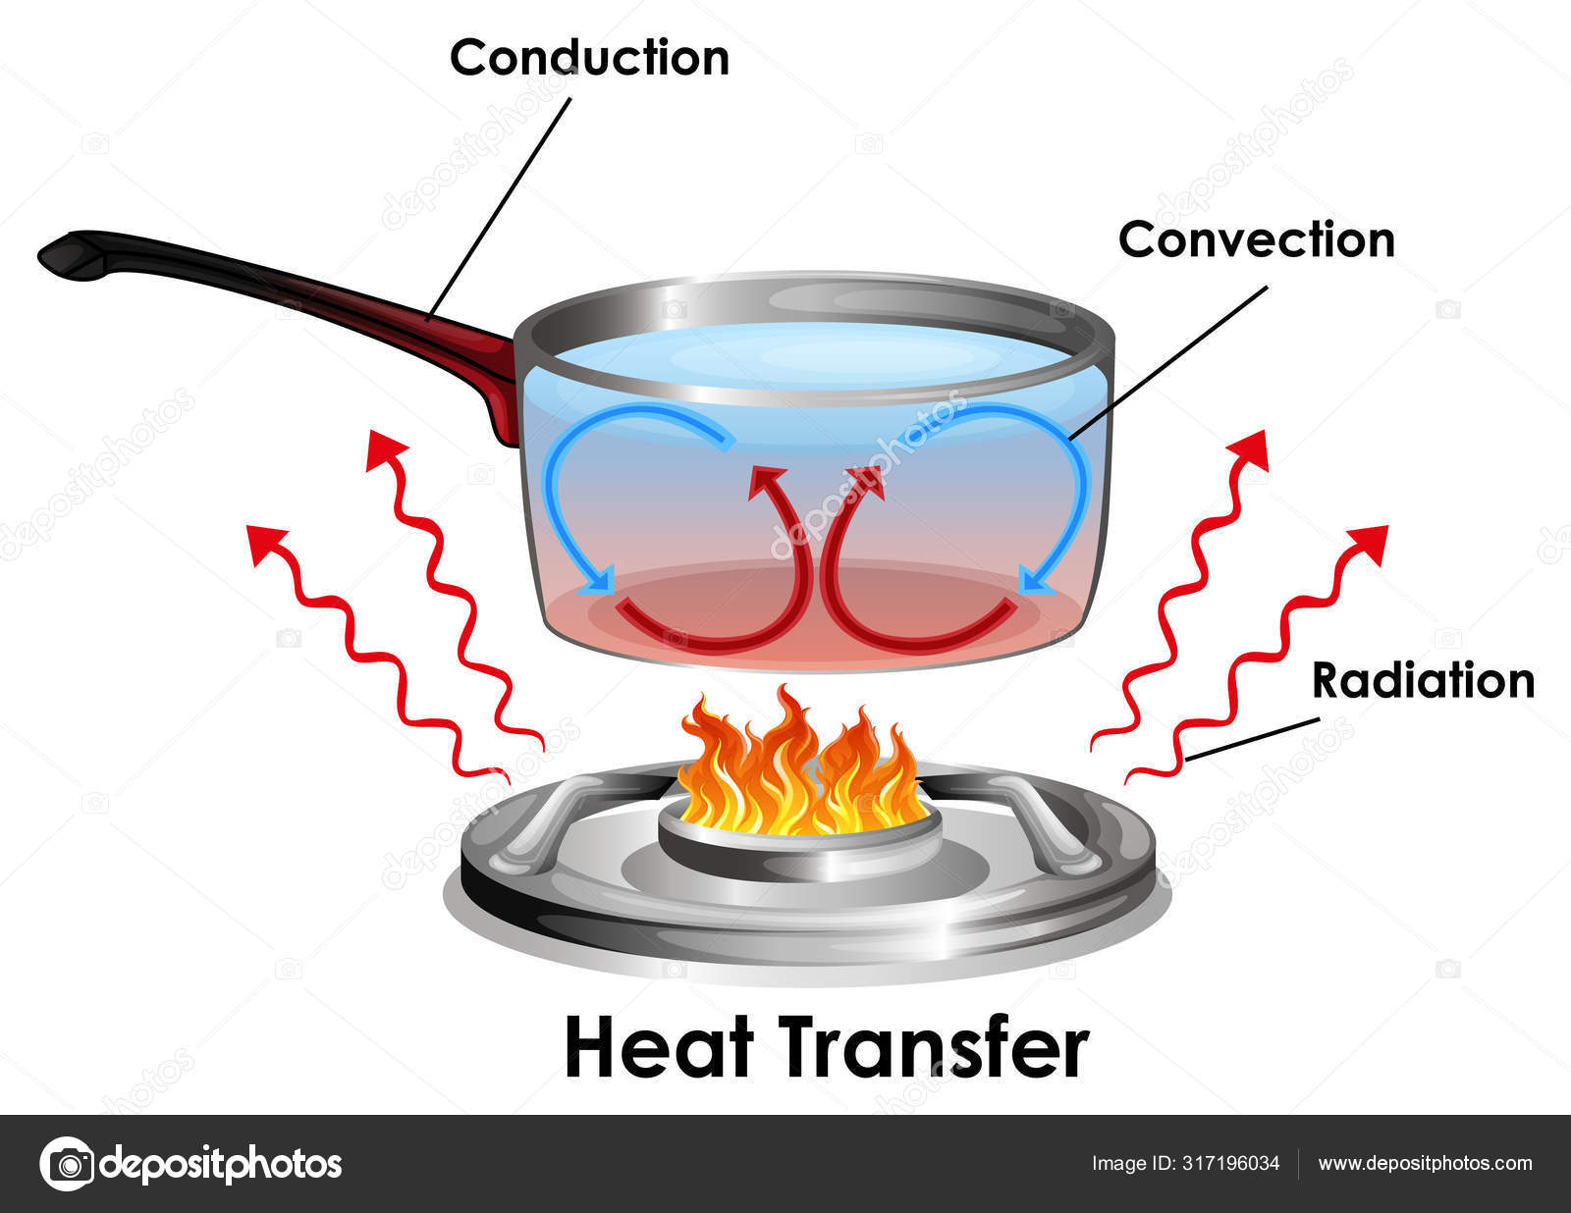
Video link: Conduction, Convection, Radiation
Video Link; Heat Transfer

Slide 10
Homework for Science
Monday:
Tuesday:
Wednesday:
Thursday:

Slide 11
Monday, January 9
Standard: Plan and carry out an investigation to demonstrate how energy from the sun transfers heat to air, land and water at different rates. (Clarification statement: Heat transfer should include the processes of conduction, convection, and radiation.)
Learning Target: I can explain how energy from the sun transfers heat to air, land, and water.
Warm-up: Chapter 13 Workbook Packet
Work Session: Unit: 3 Weather and Climate; Conduction, Convection, and Radiation; Workbook Packet Ch. 11 335-340; Science Fair Project
Closing: TOD
Reminders: Quiz on 1/11

Slide 12
Tuesday, January 10
Standard: S6E4.b Plan and carry out an investigation to demonstrate how energy from the sun transfers heat to air, land and water at different rates. (Clarification statement: Heat transfer should include the processes of conduction, convection, and radiation.)
c)Develop a model demonstrating the interaction between unequal heating and the rotation of the Earth that causes local and global wind systems.
Learning Target: I can explain heat transfer by conduction, convection, radiation.
Warm-up: Chapter 11 Workbook Packet
Work Session: Unit: 3 Weather and Climate; Conduction, Convection, and Radiation; Science Fair Project
Closing: Think Pair Share
Reminders: Quiz on 1/11

Slide 13
Wednesday, January 11
Standard: S6E4.b Plan and carry out an investigation to demonstrate how energy from the sun transfers heat to air, land and water at different rates. (Clarification statement: Heat transfer should include the processes of conduction, convection, and radiation.)
c)Develop a model demonstrating the interaction between unequal heating and the rotation of the Earth that causes local and global wind systems.
Learning Target: I can explain heat transfer by conduction, convection, radiation.
Warm-up: Chapter 11 & 13 Workbook Packet
Work Session: Unit: 3 Weather and Climate; Textbook Ch.11 p.386-392; Textbook 452-470; Science Fair Project
Closing: Think Pair Share
Reminders: Quiz on S6E4.b

Slide 14
Thursday, January 12
Standard: S6E4.c
c)Develop a model demonstrating the interaction between unequal heating and the rotation of the Earth that causes local and global wind systems.
Learning Target: I can explain how unequal heating and rotation of Earth causes wind systems.
Warm-up: Chapter 11 & 13 Workbook Packet
Work Session: Unit: 3 Weather and Climate; Textbook Ch.11 p.395-398; Science Fair Project
Closing: Student summarize
Reminders: Science Fair Projects

Slide 15
Friday, January 13
Standard: S6E4.b Plan and carry out an investigation to demonstrate how energy from the sun transfers heat to air, land and water at different rates. (Clarification statement: Heat transfer should include the processes of conduction, convection, and radiation.)
c)Develop a model demonstrating the interaction between unequal heating and the rotation of the Earth that causes local and global wind systems.
Learning Target: I can explain how unequal heating and rotation of Earth causes wind systems.
Warm-up: Chapter 11 & 13 Workbook Packet
Work Session: Stations; Textbook p. 395-398; Science Fair Project
Closing: Think Pair Share
Reminders:

Slide 17
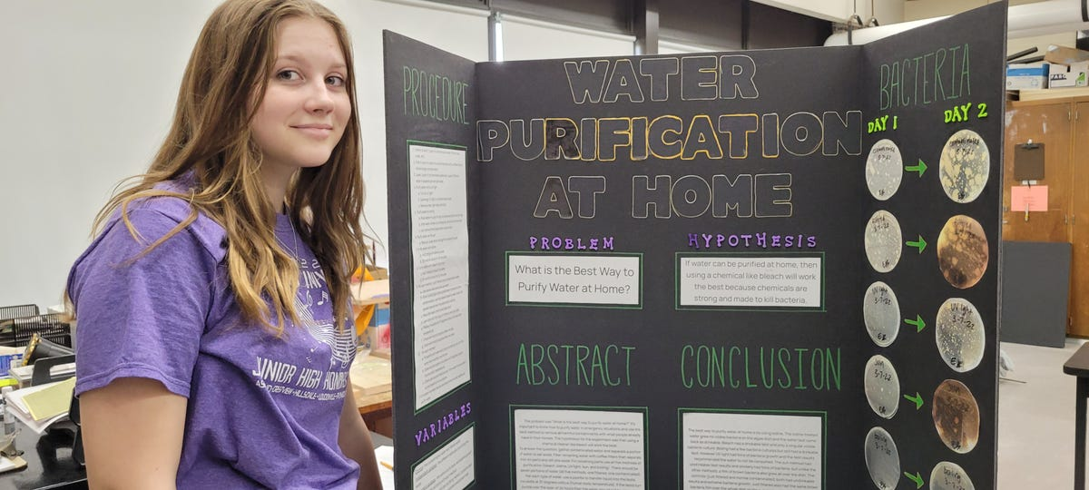
Science Fair Project
Video Link to How to do a Science Fair Project

Slide 18
Video Link to video

